Slide 1



Welcome to the experiment!
Before we start, we will ask you to rate some photographs according to how much you like them.
Please use the mouse to indicate your rating, as shown below.
Not at all
Very much
How much do you like this photograph?
Continue

Slide 2
Now we will start the experiment.
Your job in this experiment is to be an art dealer.
We will show you photographs taken by professional photographers.
You will choose photographs for an upcoming auction. Then the photographs will go on auction and you will find out whether you profited from each photograph or not.
Your goal should be to choose photographs that will maximize your profits.

Slide 3
Now we will start the experiment.
Your job in this experiment is to be an art dealer.
We will show you photographs taken by professional photographers.
You will choose photographs for an upcoming auction. Then the photographs will go on auction and you will find out whether you profited from each photograph or not.
Your goal should be to choose photographs that will maximize your profits.
One of your decisions will be played out for real, and you will receive 1% of the auction earnings for your chosen photograph (for example, if the photograph earned $157, you will receive $1.57, if it resulted in no earnings, you will not receive a bonus for this phase of the experiment).

Slide 4
So, get ready to make some choices.
Please take your time and consider each choice carefully. Because these choices are important, we will give you a chance to practice making each choice a couple of times before you commit to your final decision.
We are interested in your deliberation process, so we will occasionally ask you to share with us the reasons for choosing one specific photograph over the other photograph. In these explanations, you may refer to any internal thoughts or external features that led to your decision.

Slide 5
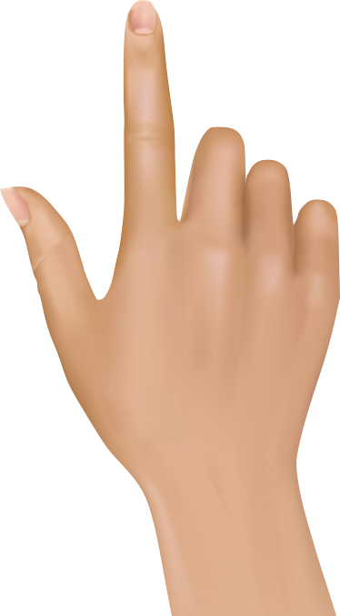
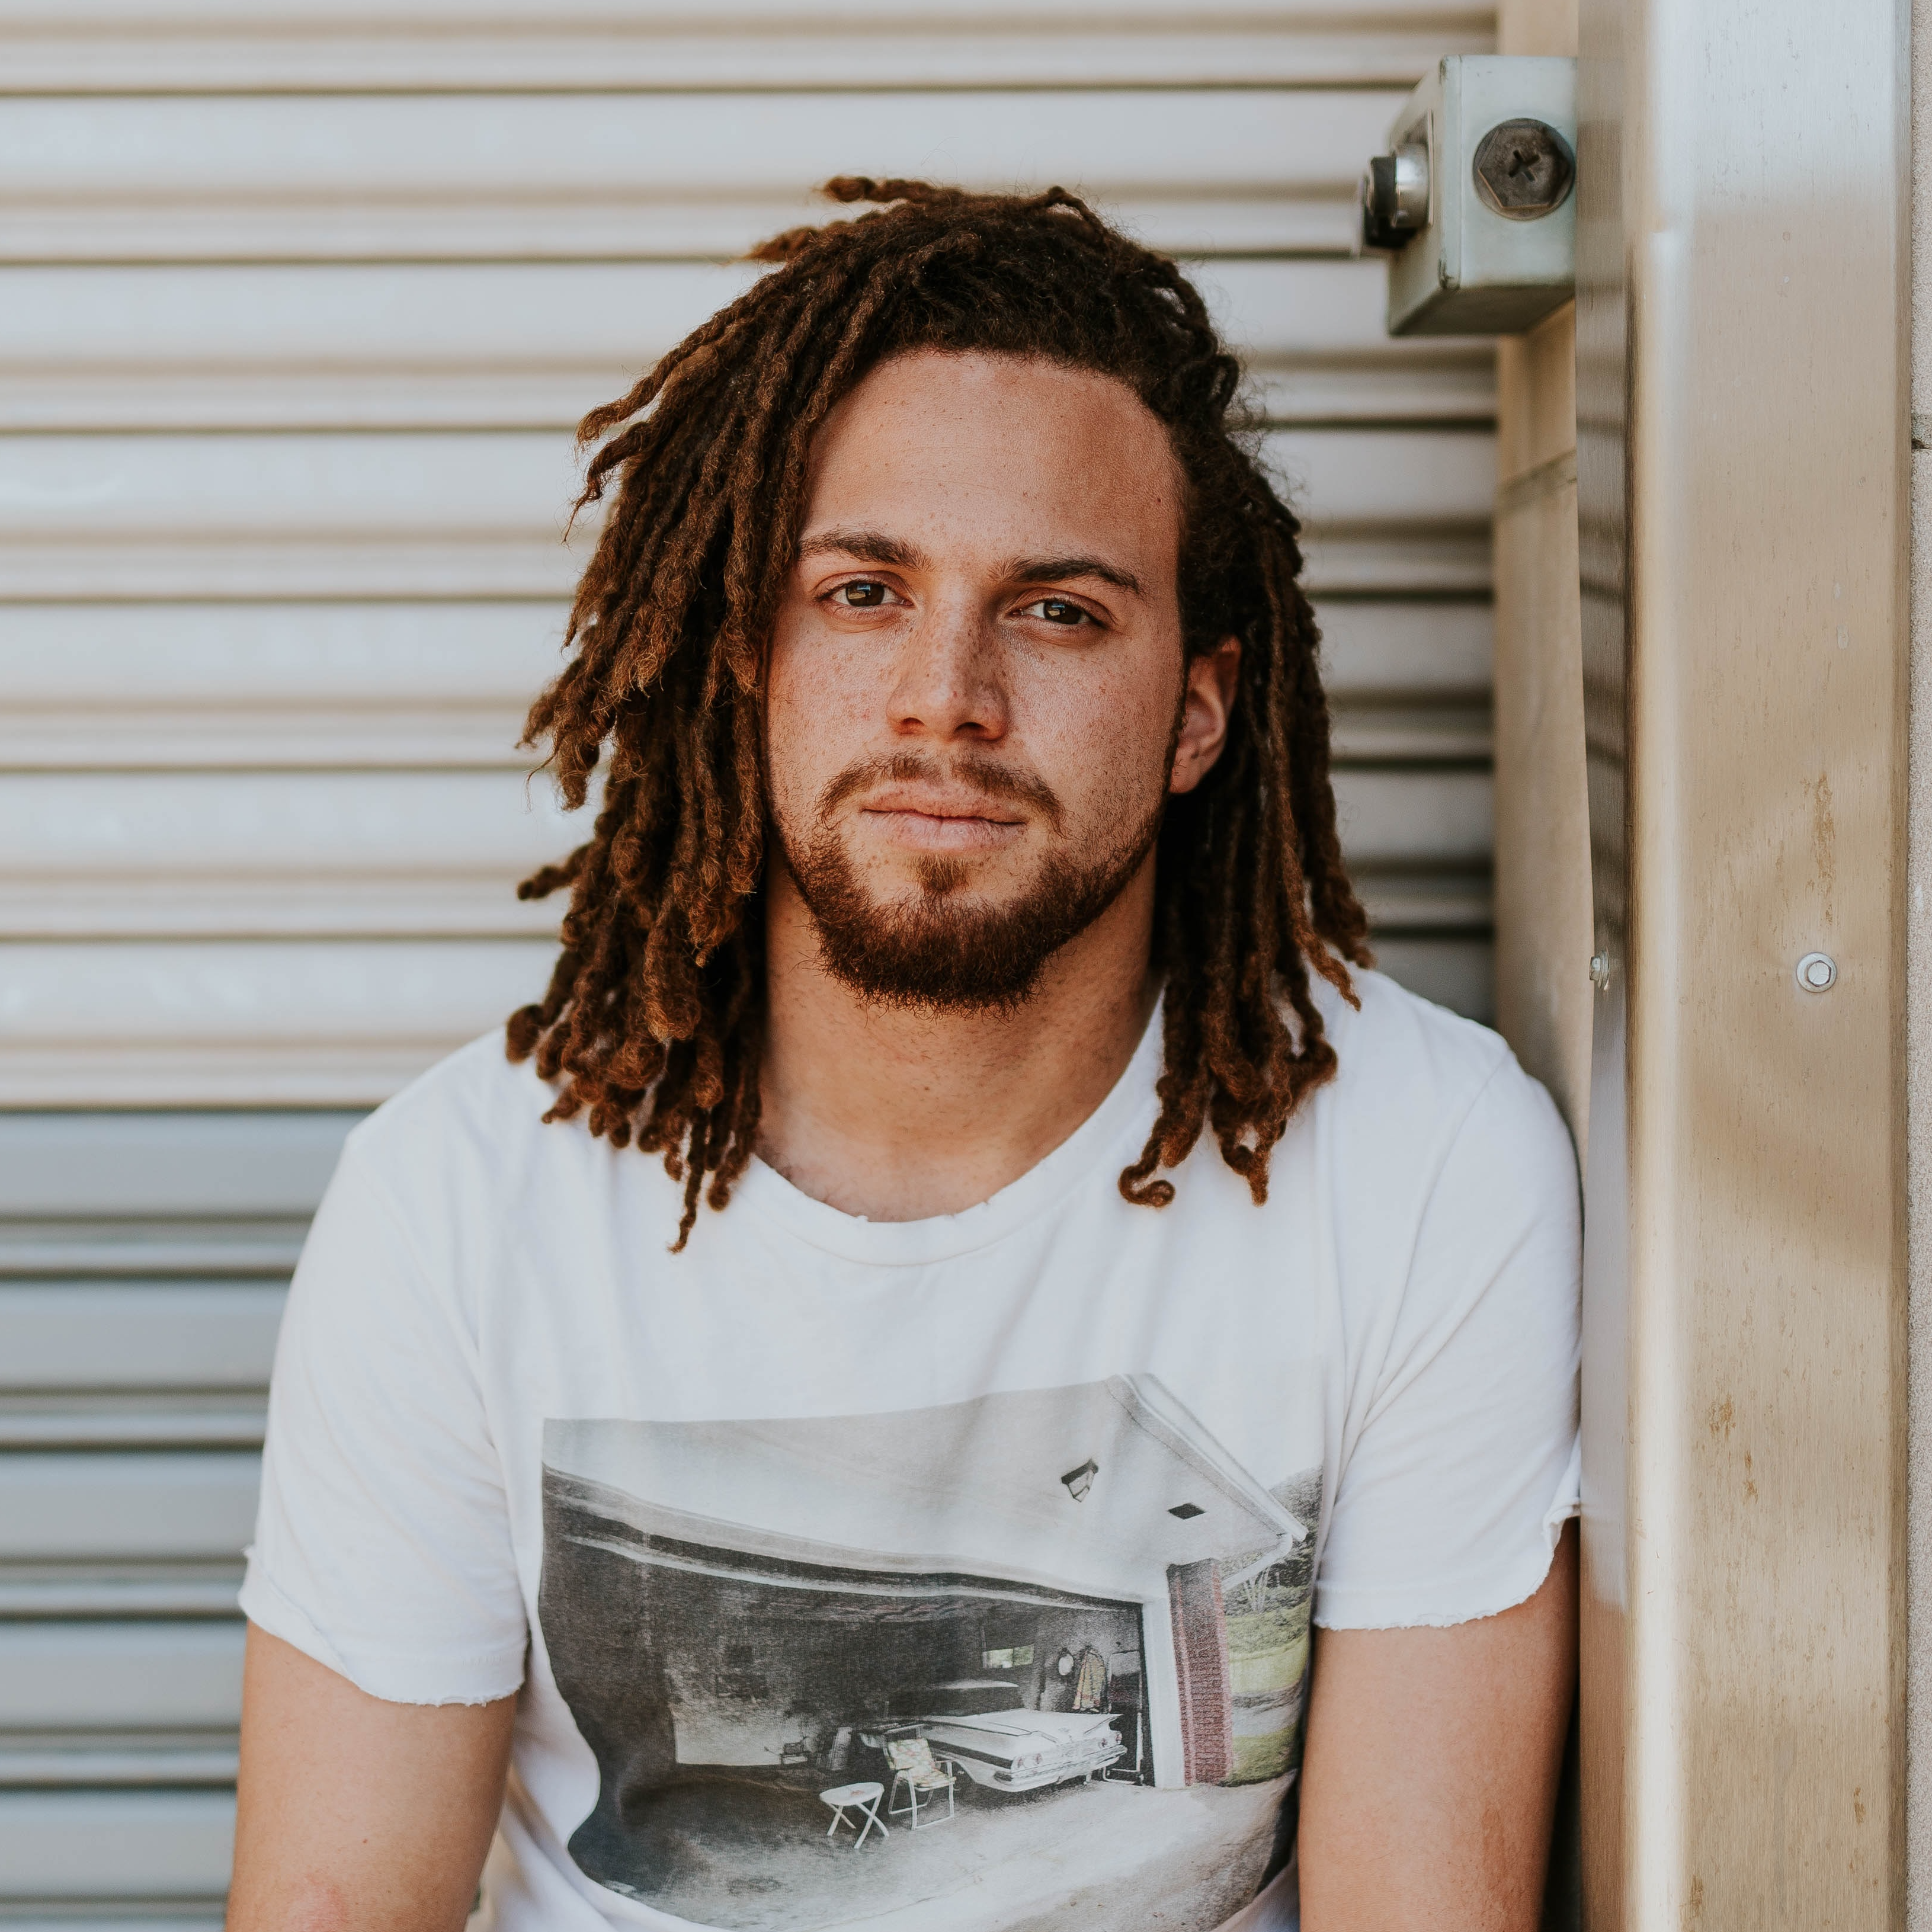


Please place your right index finger on the “K” key, and your left index finger on the “D” key (as presented below).
Press “K” to choose the right photograph, and “D” to choose the left photograph.
You will have up to 10 seconds to make your choice, giving you plenty of time to consider it carefully.
Which photograph do you choose?
Which photograph do you choose?

Slide 6

Are you ready to find out how well your selected photographs did at the auction?
We will show you whether each photograph you chose was sold with a gain (sold higher than the price you paid for it), or with no gain ($0 earnings). Two examples are shown below.
We will also tell you at the end of this phase whether and how much extra bonus money you earned from your decisions (remember, one of those will be played out for real earning).
Later in the experiment, this information will help you earn more bonus money.
$0 Earnings
Gain of $157

Slide 7
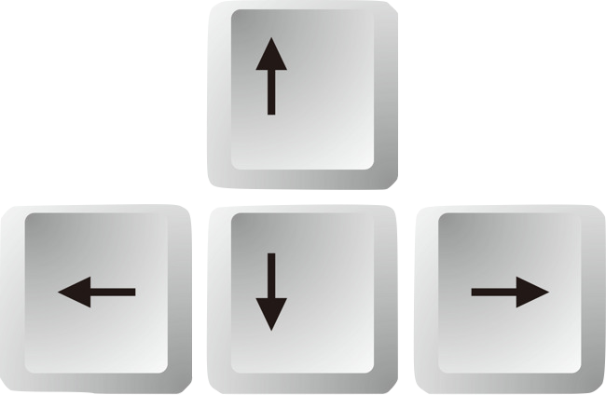
To help you learn better, we will present the outcomes for your selected photographs several times.
To observe the outcomes, you will need to respond, as follows:
When the painting appears, press the SPACE bar. When the outcome appears, press “down arrow” for No gain, and press “up arrow” for Gain.
Use your left hand to press the SPACE bar and your right hand to press the up or down arrows.
$0 Earnings
Gain of $157

Slide 8
Now that you are an expert art dealer, you are asked to prepare a portfolio of high-value photographs.
You will make a series of new choices among photographs. We will pay you additional bonus money based on your choices in this phase of the experiment.
Please place your right index finger on the ”K” key, and the left index finger on the “D” key.
To choose the left painting press “D”, and to choose the right painting press “K”
You will have up to 2.5 seconds to make each decision.
Which photograph do you choose?
Which photograph do you choose?

Slide 9
Let’s check what you remember from the beginning of the experiment where you had to decide which photograph should go on auction (up to 10 seconds).
You will see pairs of photographs. Please tell us whether you already saw this exact pair in the beginning of the experiment (”Intact”/up arrow) or whether this is a recombined pair you have not seen before (“Recombined”/down arrow). Recombined pairs include photographs you have seen before, yet not in this unique pairing.
We will also ask you what you remember about the choices you made in the beginning of the experiment (using “D” and “K” keys).
Is this pair
Intact (up) or Recombined (down)?
Which photograph did you choose?
Which photograph did you choose?
INTACT

Slide 10
In this next phase, you are asked to rate how much you like the photographs you’ve seen throughout the experiment.
Please use the mouse to indicate your rating, as shown below.
Not at all
Very much
How much do you like this photograph?
Continue

Slide 11

Before the experiment ends, we will ask you to tell us what the outcomes of the auction were.
In the beginning of the experiment, you chose photographs to go for auction and learned how much they profited. Later on, the remaining photographs (those you didn’t choose) also went on auction.
In this phase of the experiment, we will show you all the photographs you deliberated about (both those you chose and those you didn’t choose). For each photograph, please estimate whether it resulted in a GAIN (up arrow) or NO GAIN (down arrow) from the auction. Then, please rate how confident you are in your response.
What was the auction profit of this photograph?
Gain (up) / No gain (down)
GAIN
1
Completely
unsure
6
Completely
sure
2
3
4
5
How confident you are in your response?
Continue

Slide 12
You will now take a short quiz to make sure you understood the instructions.

Slide 13
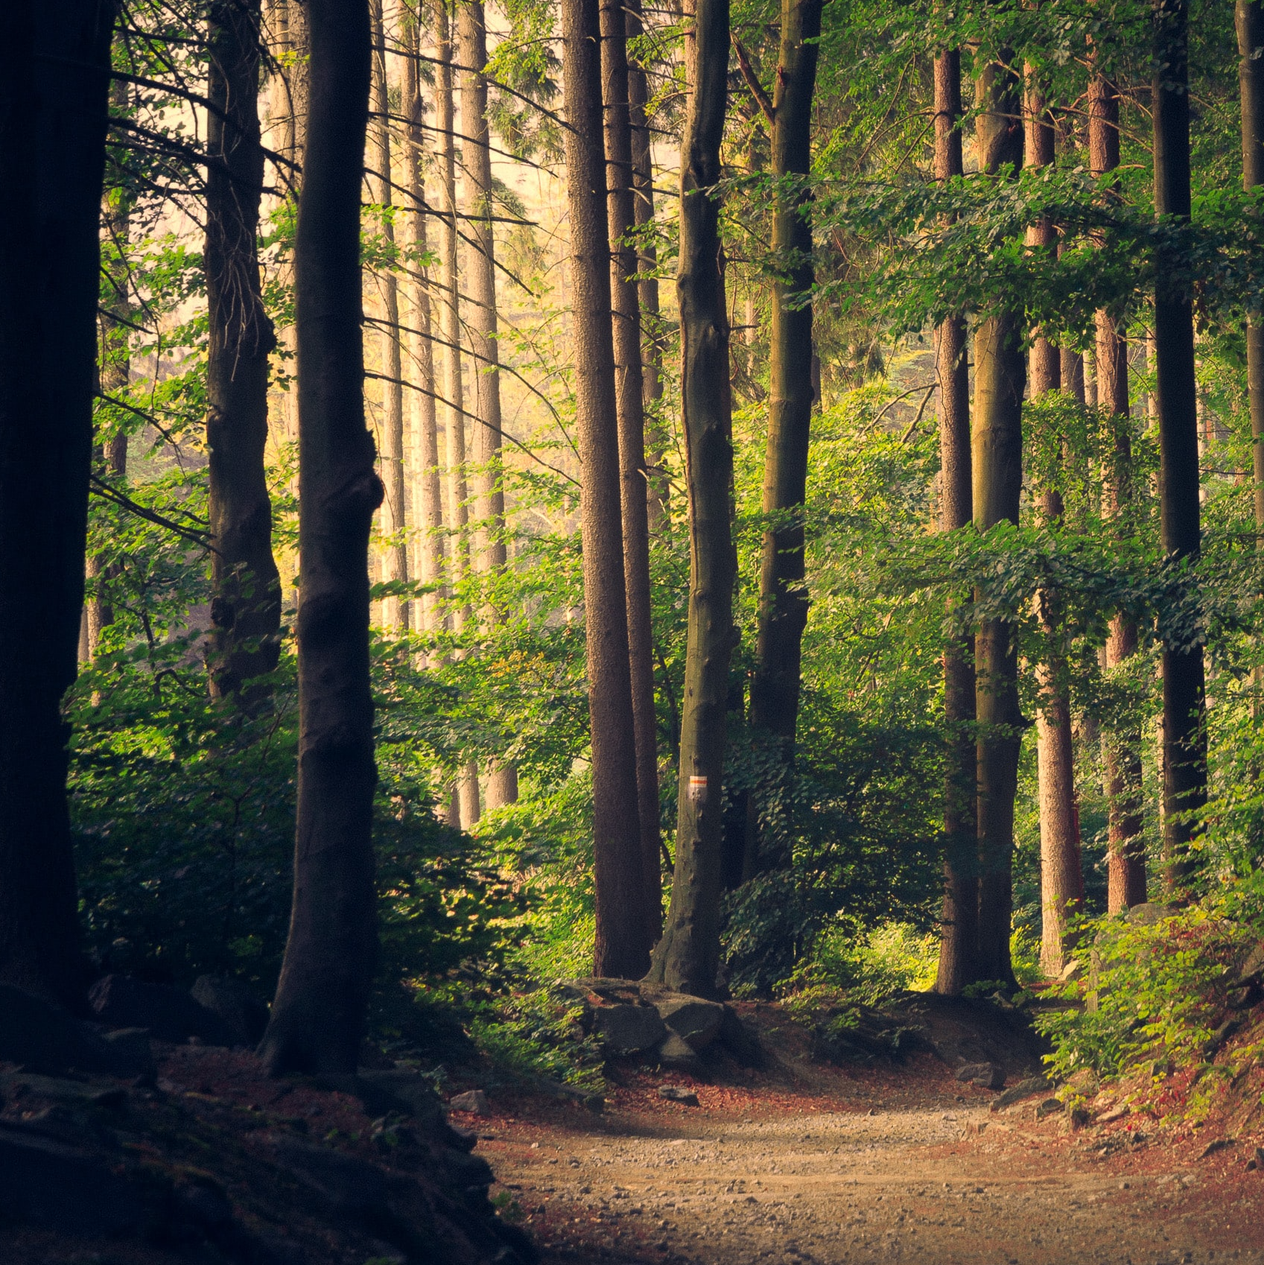
Welcome to the experiment!
Before we start, we will ask you to rate some photographs according to how much you like them.
Please use the mouse to indicate your rating, as shown below.
Not at all
Very much
How much do you like this photograph?
Continue

Slide 14
Now we will start the experiment.
Your job in this experiment is to be an art dealer.
We will show you photographs taken by professional photographers.
You will choose photographs for an upcoming auction. Then the photographs will go on auction and you will find out whether you profited from each photograph or not.
Your goal should be to choose photographs that will maximize your profits.

Slide 15
Now we will start the experiment.
Your job in this experiment is to be an art dealer.
We will show you photographs taken by professional photographers.
You will choose photographs for an upcoming auction. Then the photographs will go on auction and you will find out whether you profited from each photograph or not.
Your goal should be to choose photographs that will maximize your profits.
One of your decisions will be played out for real, and you will receive 1% of the auction earnings for your chosen photograph (for example, if the photograph earned $157, you will receive $1.57, if it resulted in no earnings, you will not receive a bonus for this phase of the experiment).

Slide 16
So, get ready to make some choices.
Please take your time and consider each choice carefully. Because these choices are important, we will give you a chance to practice making each choice a couple of times before you commit to your final decision.
We are interested in your deliberation process, so we will occasionally ask you to share with us the reasons for choosing one specific photograph over the other photograph. In these explanations, you may refer to any internal thoughts or external features that led to your decision.

Slide 17

Please place your right index finger on the “K” key, and your left index finger on the “D” key (as presented below).
Press “K” to choose the right photograph, and “D” to choose the left photograph.
You will have up to 10 seconds to make your choice, giving you plenty of time to consider it carefully.
Which photograph do you choose?
Which photograph do you choose?

Slide 18
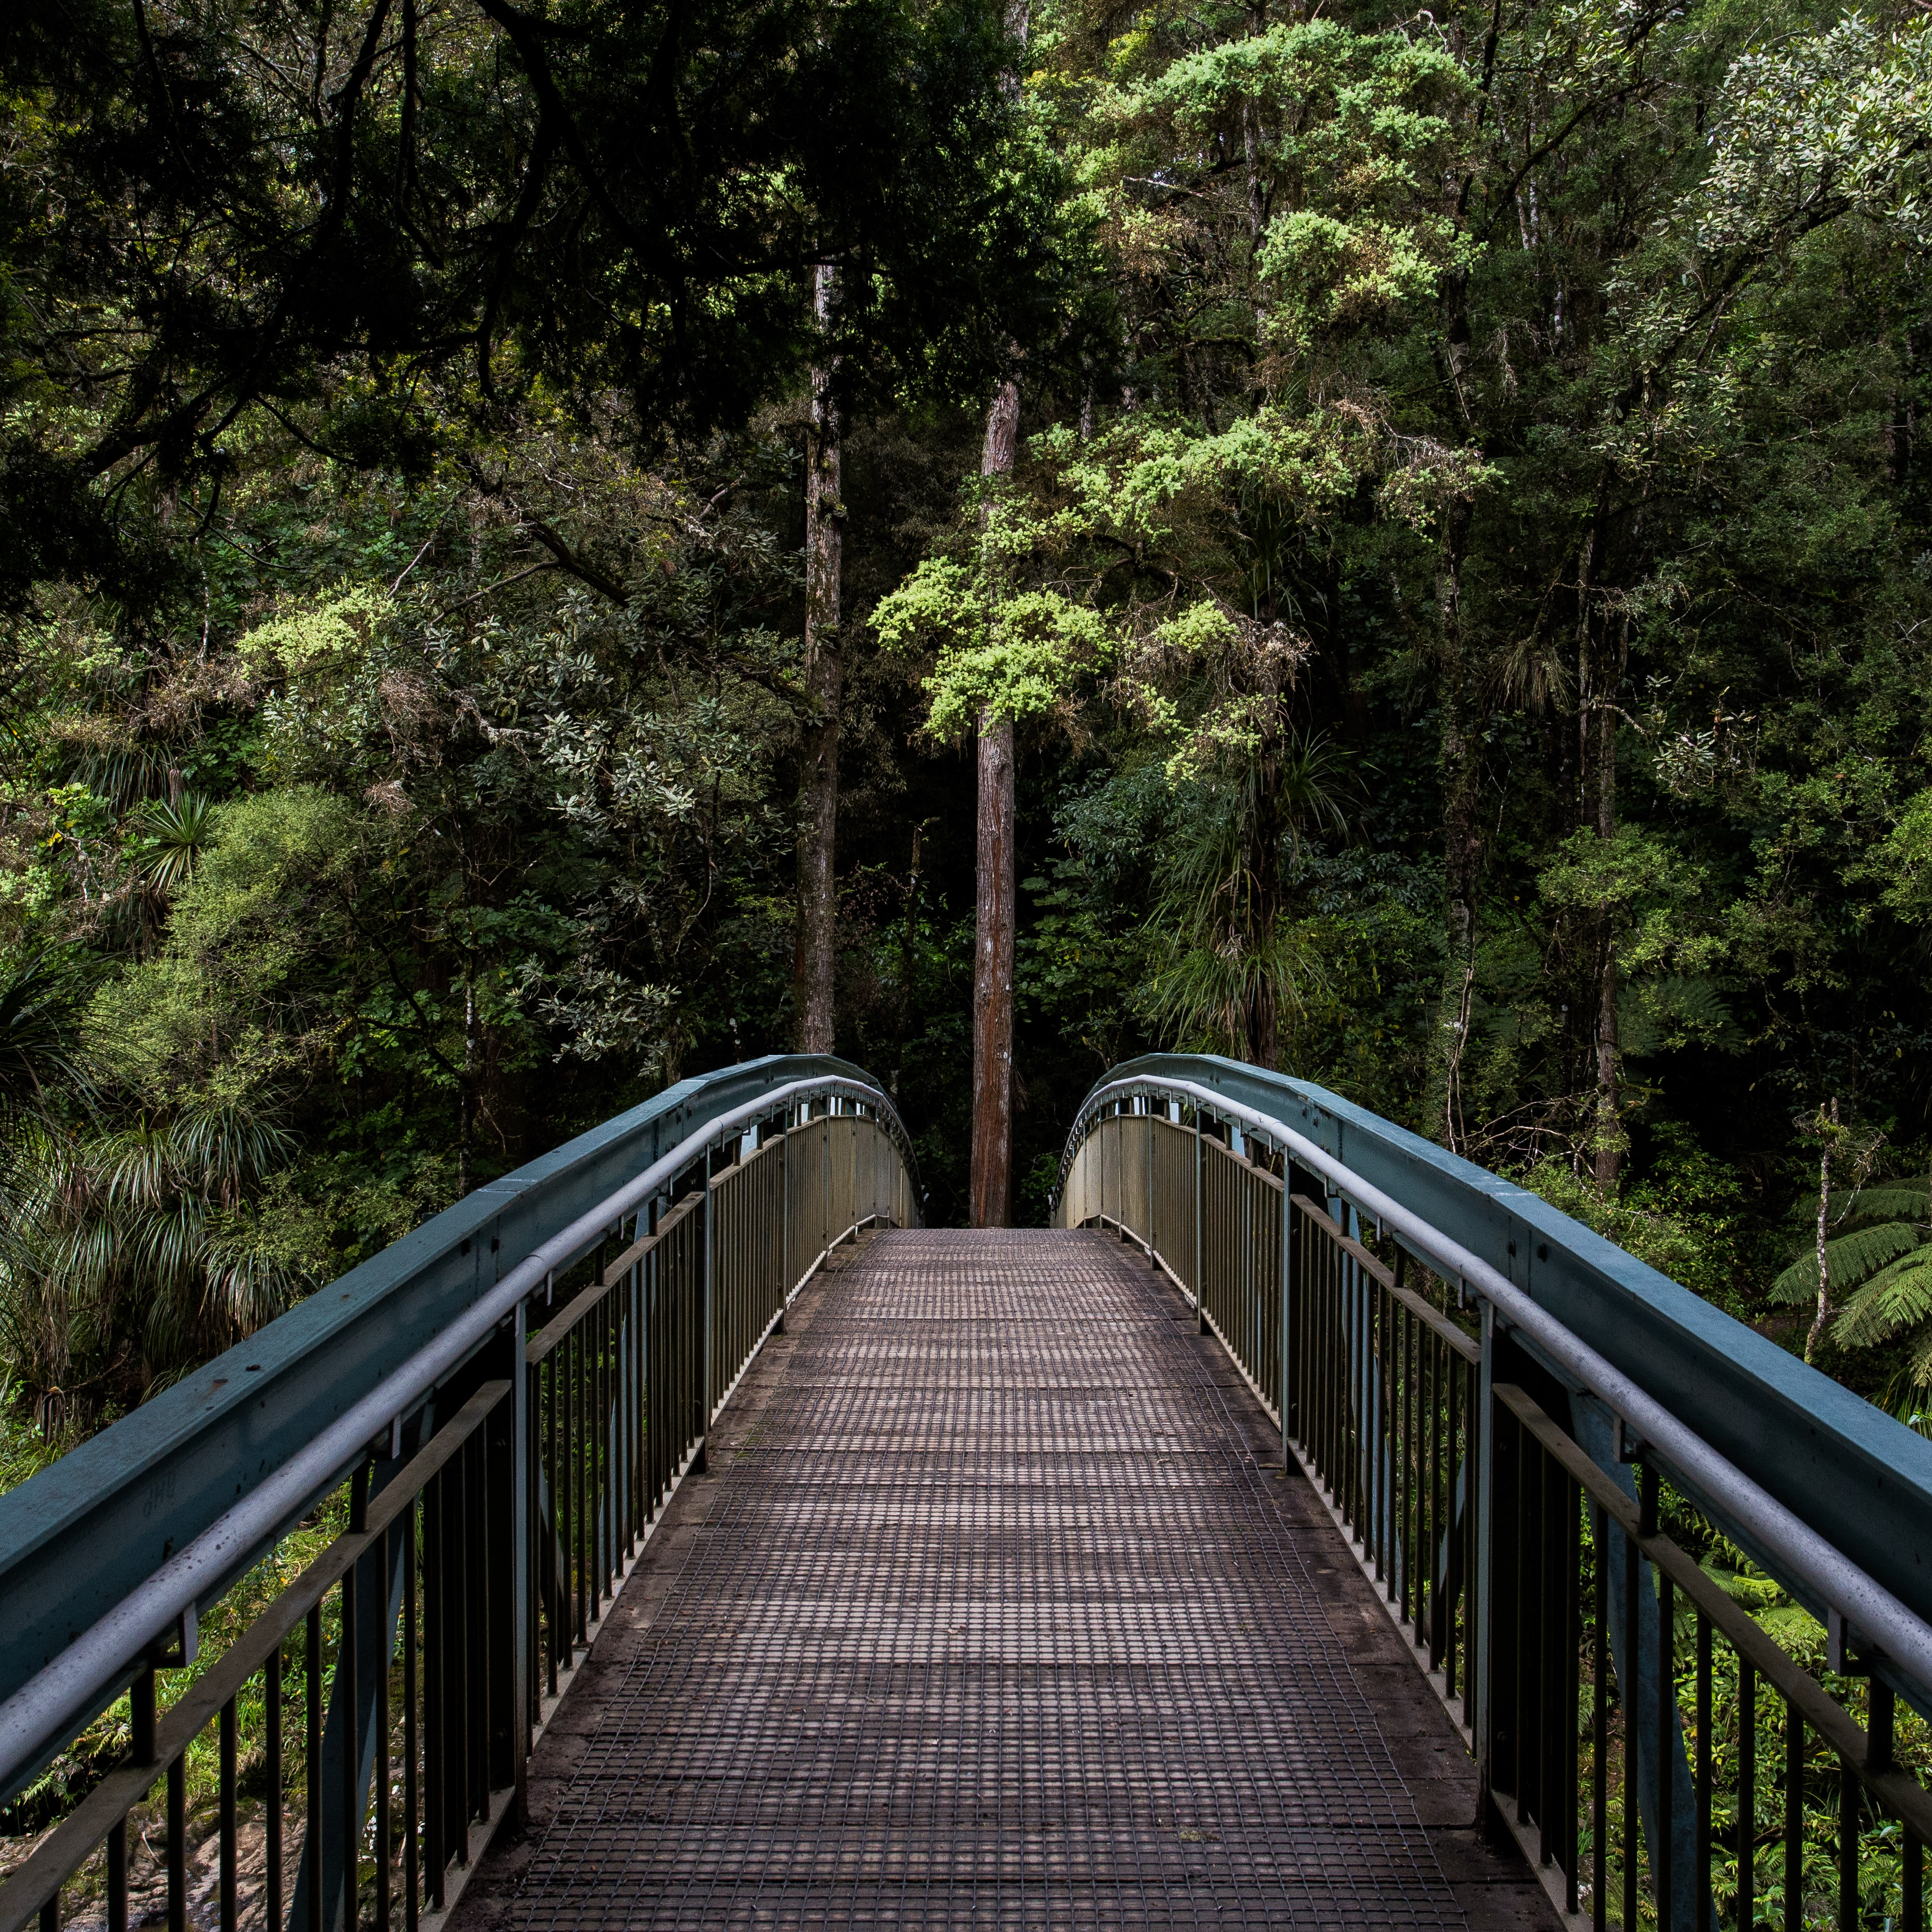
Are you ready to find out how well your selected photographs did at the auction?
We will show you whether each photograph you chose was sold with a gain (sold higher than the price you paid for it), or with no gain ($0 earnings). Two examples are shown below.
We will also tell you at the end of this phase whether and how much extra bonus money you earned from your decisions (remember, one of those will be played out for real earning).
Later in the experiment, this information will help you earn more bonus money.
$0 Earnings
Gain of $157

Slide 19
To help you learn better, we will present the outcomes for your selected photographs several times.
To observe the outcomes, you will need to respond, as follows:
When the painting appears, press the SPACE bar. When the outcome appears, press “down arrow” for No gain, and press “up arrow” for Gain.
Use your left hand to press the SPACE bar and your right hand to press the up or down arrows.
$0 Earnings
Gain of $157

Slide 20
Now that you are an expert art dealer, you are asked to prepare a portfolio of high-value photographs.
You will make a series of new choices among photographs. We will pay you additional bonus money based on your choices in this phase of the experiment.
Please place your right index finger on the ”K” key, and the left index finger on the “D” key.
To choose the left painting press “D”, and to choose the right painting press “K”
You will have up to 2.5 seconds to make each decision.
Which photograph do you choose?
Which photograph do you choose?

Slide 21
Let’s check what you remember from the beginning of the experiment where you had to decide which photograph should go on auction (up to 10 seconds).
You will see pairs of photographs. Please tell us whether you already saw this exact pair in the beginning of the experiment (”Intact”/up arrow) or whether this is a recombined pair you have not seen before (“Recombined”/down arrow). Recombined pairs include photographs you have seen before, yet not in this unique pairing.
We will also ask you what you remember about the choices you made in the beginning of the experiment (using “D” and “K” keys).
Is this pair
Intact (up) or Recombined (down)?
Which photograph did you choose?
Which photograph did you choose?
INTACT

Slide 22
In this next phase, you are asked to rate how much you like the paintings you’ve seen
throughout the experiment.
Please use the mouse to indicate your rating, as shown below.
Not at all
Very much
How much do you like this photograph?
Continue

Slide 23
Before the experiment ends, we will ask you to tell us what the outcomes of the auction were.
In the beginning of the experiment, you chose photographs to go for auction and learned how much they profited. Later on, the remaining photographs (those you didn’t choose) also went on auction.
In this phase of the experiment, we will show you all the photographs you deliberated about (both those you chose and those you didn’t choose). For each photograph, please estimate whether it resulted in a GAIN (up arrow) or NO GAIN (down arrow) from the auction. Then, please rate how confident you are in your response.
What was the auction profit of this photograph?
Gain (up) / No gain (down)
GAIN
1
Completely
unsure
6
Completely
sure
2
3
4
5
How confident you are in your response?
Continue

Slide 24
You will now take a short quiz to make sure you understood the instructions.

